Slide 1
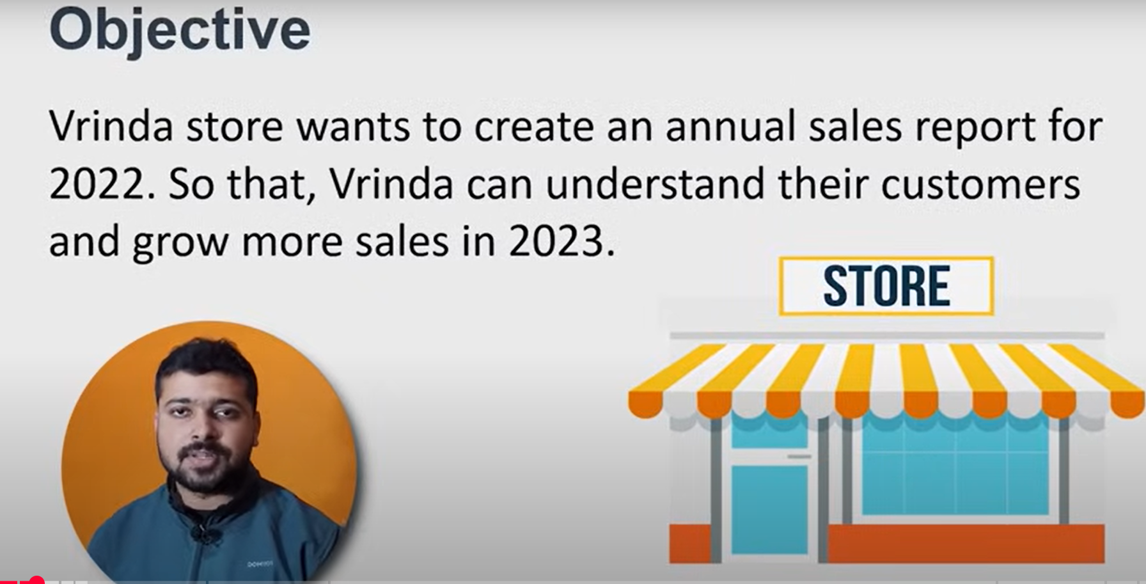

Slide 2
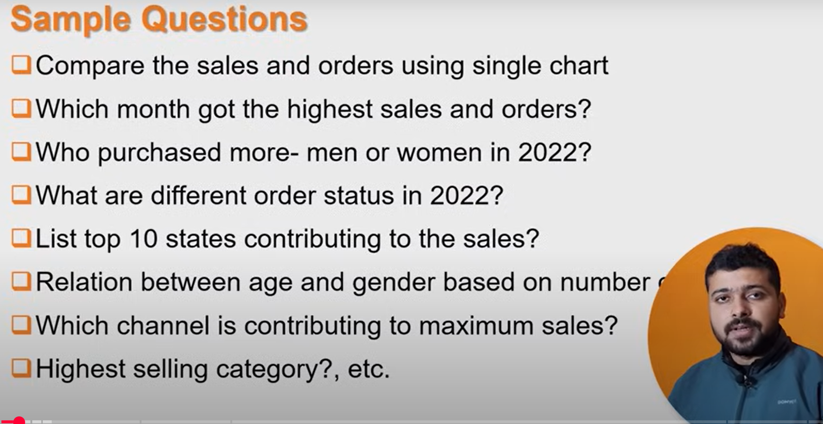

Slide 3
Data Cleaning(Remove Duplicate,Blank,Null etc.)
Data Processing (Add more column ,Extract another column,New Calculation etc.)

Slide 4
